Slide 1
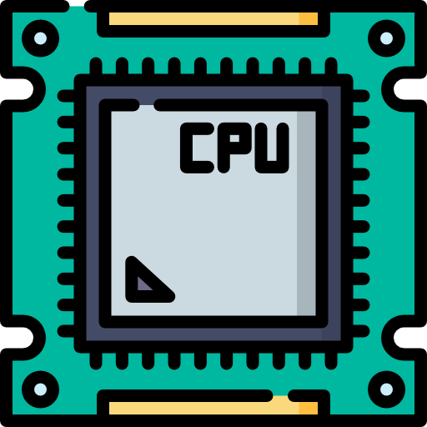
Pipelining in Processors: Enhancing CPU Performance
Course Code : SE 222 || Section : G
Farjan Ahmmed
232-35-738

Slide 2
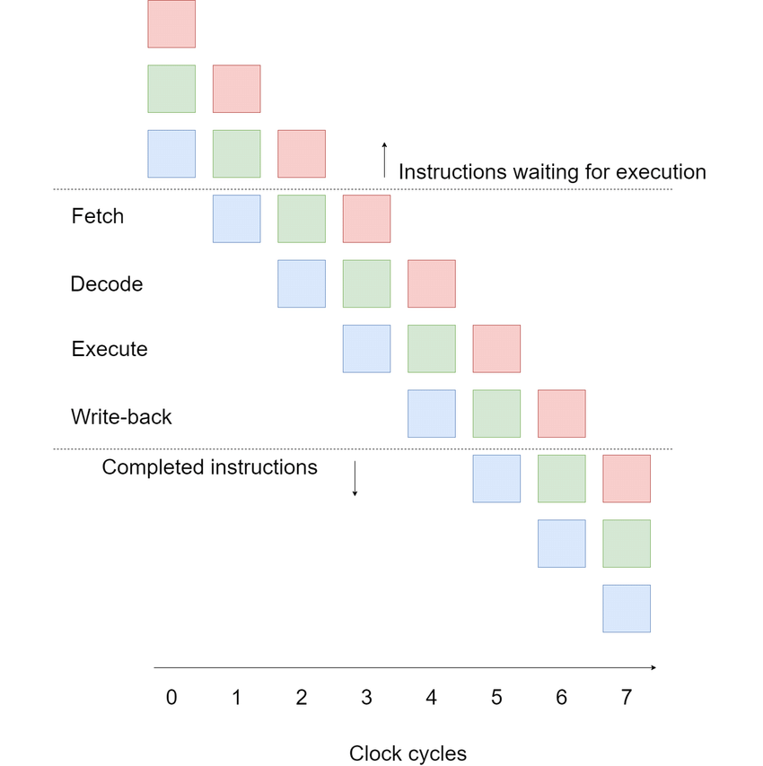
What is Pipelining?
Sequential Processing
Traditional CPUs execute instructions one at a time, completing each instruction before starting the next.
Pipelining
Pipelining breaks down instruction execution into multiple stages, allowing multiple instructions to be processed concurrently.

Slide 3

Principles of Pipelining
1
Pipelining breaks instruction execution into stages, allowing multiple instructions to be in progress simultaneously.
2
Each stage completes a specific task, such as fetching, decoding, executing and writing back the results.
3
This concurrent execution increases throughput, allowing more instructions to be processed in a given time.

Slide 4
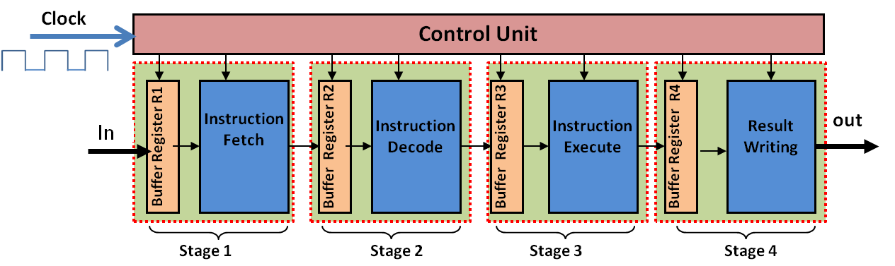
How Pipelining Works
1. Instruction Fetch
2. Instruction Decode
3. Execution
4. Memory Access
5. Write-Back

Slide 5
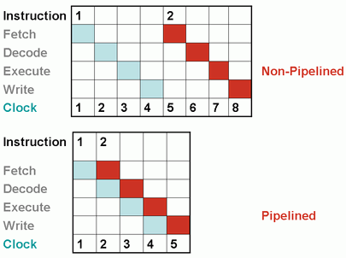
Performance Impact
Metric: Instructions Per Cycle (IPC) measures how many instructions a CPU executes per clock cycle.
Without Pipelining: Execution time = n×tn \times tn×t (sequential execution).
With Pipelining: Execution time ≈ n/kn / kn/k, where kkk = pipeline stages (overlapping execution improves throughput).
Result: Pipelining increases IPC and reduces average execution time.

Slide 6

Benefits of Pipelining
Increased Throughput
Higher Clock Speed
Multiple instructions can be completed simultaneously.
CPUs achieve higher clock frequencies due to optimized stages.
Efficient Resource Utilization
CPU components remain active, minimizing idle time.

Slide 7

Challenges in Pipelining
Data Dependencies
Branch Prediction
Instructions may need results from previous instructions, causing stalls.
Predicting which path to take in conditional branches is crucial.
Out-of-Order Execution
Reordering instructions to optimize performance requires careful management.

Slide 8


Solutions for Pipelining Challenges
Forwarding
1
Pass results directly to dependent instructions.
2
Stall Cycles
Pause execution to resolve data dependencies.
Branch Prediction
3
Predict the outcome of branch instructions to avoid stalls.
4
Speculative Execution
Execute instructions speculatively before confirming the branch outcome.
Additional Hardware
5
Increase resources to handle simultaneous operations.
6
Resource Sharing Avoidance
Optimize resource allocation to avoid conflicts.

Slide 9
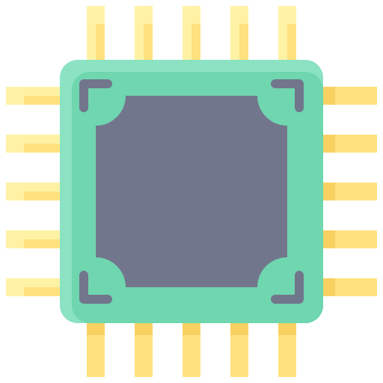
Modern CPU Examples
• Intel Core i9: Superscalar pipelining with multiple parallel pipelines.
• ARM Cortex Processors: Optimized pipelining for energy efficiency.
• RISC-V: Focus on simplicity and efficient pipelining.

Slide 10

Future of Pipelining
Deeper pipelines with more stages
Integration with AI-based branch prediction
Optimizations for quantum and parallel computing

Slide 11

Conclusion and Key Takeaways
Pipelining is a cornerstone of modern CPU design, enhancing performance by enabling parallel execution. Advanced techniques like branch prediction and out-of-order execution further optimize this process. Understanding these principles is crucial for comprehending the inner workings of today's computers.

Slide 12
Thank You

